Slide 1
CEE225A S21 Final Presentation Introduction of VERPAT
Arash Ghaffar, Xiangyu Li, Younghun Bahk

Slide 2
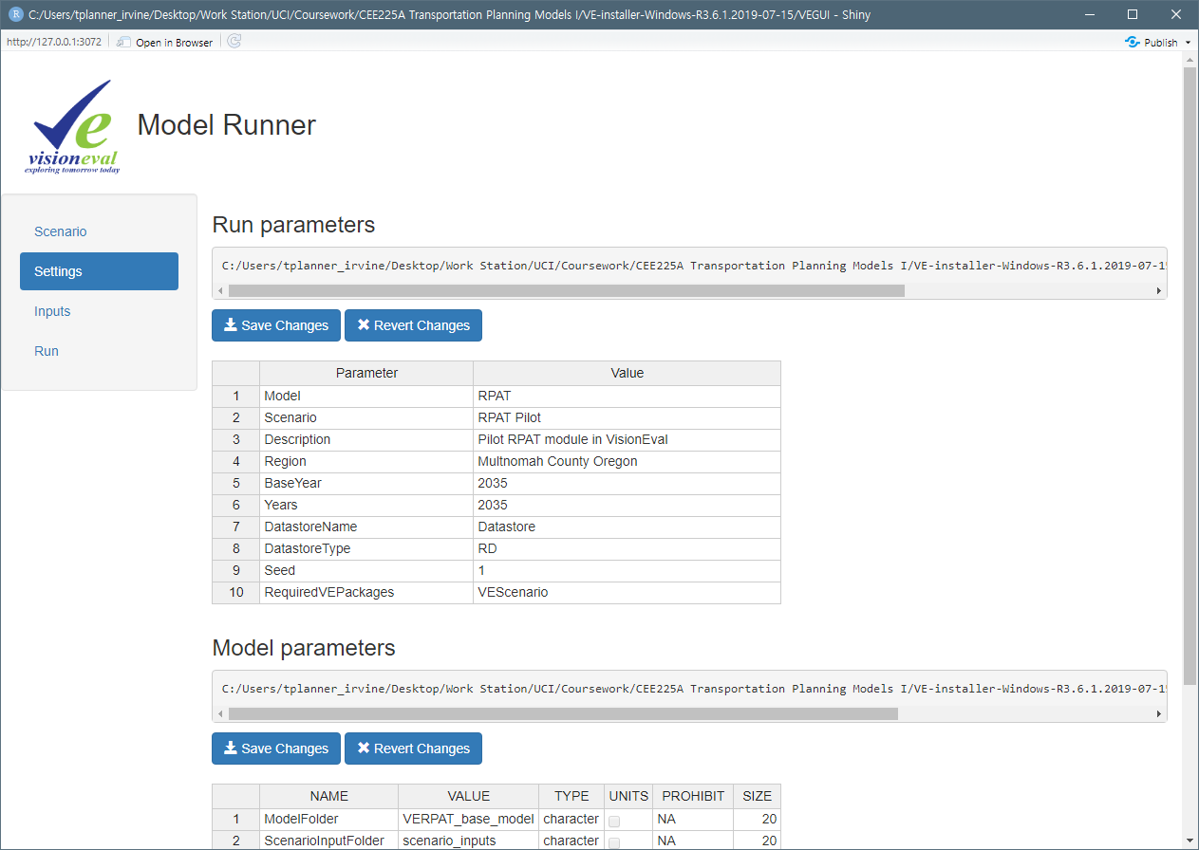
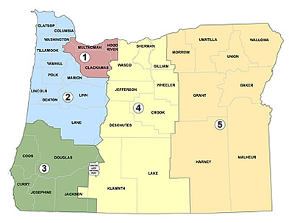
What is VERPAT? Development History of VE-RPAT
VisionEval
Rapid
Policy
Assessment
Tool
GreenSTEP
A tool measuring GHG emission outcomes in ODOT
EERPAT
Energy and Emissions Reduction Policy Analysis Tool
Available to other state transportation agencies
Transportation
supply
Vehicle
ownership
Regional Strategic Planning Model
Regional transportation agencies
Broader measures: health, household costs, outcomes…
RSPM
VisionEval: An integrated framework to run these models
Prices
Emissions
Rapid Policy Assessment Tool
Help planners evaluate the potential effect of smart growth policies on regional level
RPAT
Land use
Traffic
congestion
VisionEval
An open source modeling framework
Enables statewide, regional, or urban area models
Connecting together modules distributed in R packages
Statewide
Regional
(Revised codes)
Growth
policies
Land use
place types
GreenSTEP
+
Image: ODOT website
|
Younghun Bahk
Notes:
VERPAT stands for VisionEval Rapid Policy Assessment Tool.
The very beginning of the program was GreenSTEP. It was developed to measure and reduce greenhouse gas emissions from light-duty vehicles by Oregon DOT.
The GreenSTEP shows how household vehicle ownership and use, emissions, and traffic congestion change by factors such as transportation supply, prices, and land use.
They expanded the model from state-level to regional scale.
This version is called the RSPM: Regional Strategic Planning Model.
On top of that, RPAT added growth policies as factors, and land use place type categories.
In summary, the RPAT is basically based on the GreenSTEP, but it is available with regional-level analysis and can consider growth policies.
They made an integrated framework to run these models called VisionEval.
Indeed, we can find those models in VE directories. Precisely, there is “VE-State” instead of the GreenSTEP and EERPAT, which are state-level models.

Slide 3
What is VERPAT? Structure of VERPAT
VERPAT is an R-based software.
Modules are created in R language and executed via VisionEval, which is run by R.
VisionEval provides a GUI (VEGUI) and planners can control the whole process in VEGUI.
Module
(R package)
Input
Run
Output
Data
Run
Module
(R package)
Module
(R package)
|
Younghun Bahk
Notes:
The VERPAT is an R-based software.
Inside the R, you can run VE software with opening several R packages.
When you run the model, several modules will be run via R, but you don’t need to code directly in R-Studio.
Instead, you can control the whole process once you open the VE-GUI window. So this user-friendly GUI will help you input data, run models, and extract output data.

Slide 4
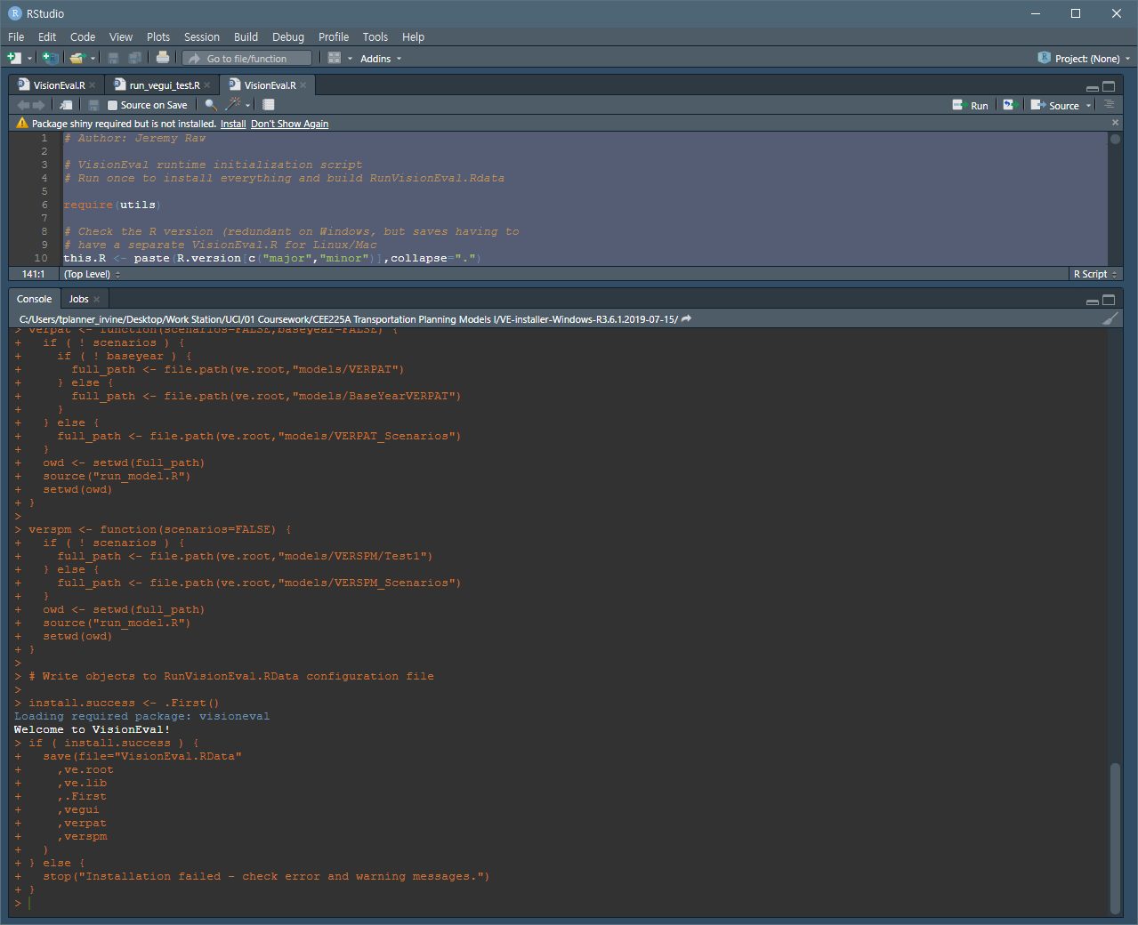
How to Install Download and Install
R-Studio with VE packages
Download VisionEval at GitHub page.
Double-click VisionEval.bat
Open VisionEval.R
Run the codes
Type “vegui()” to start the GUI
|
Younghun Bahk
Notes:
Let’s start from the installation.
You can download the VE at the GitHub page provided by Professor McNally.
After extracting the zip file, double click on VisionEval.bat.
And then, open VisionEval.R in the same folder.
You’ll see the R console and then you’ll just run the given codes.
Then, type “vegui()” and press enter. Now the GUI window will be opened and you can forget about the R.

Slide 5
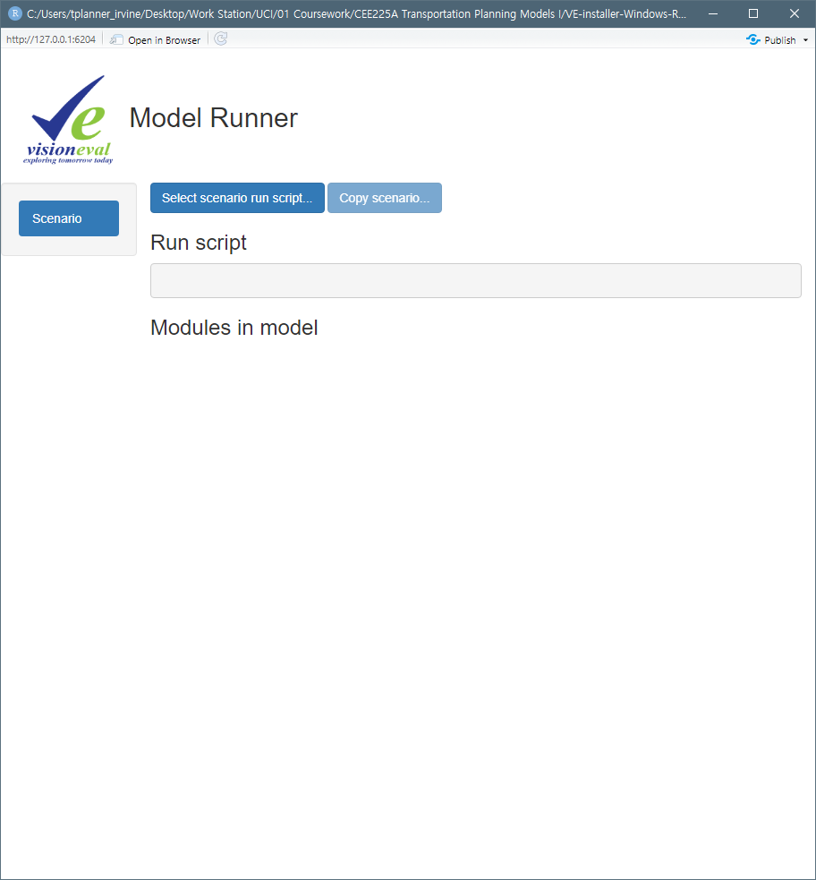
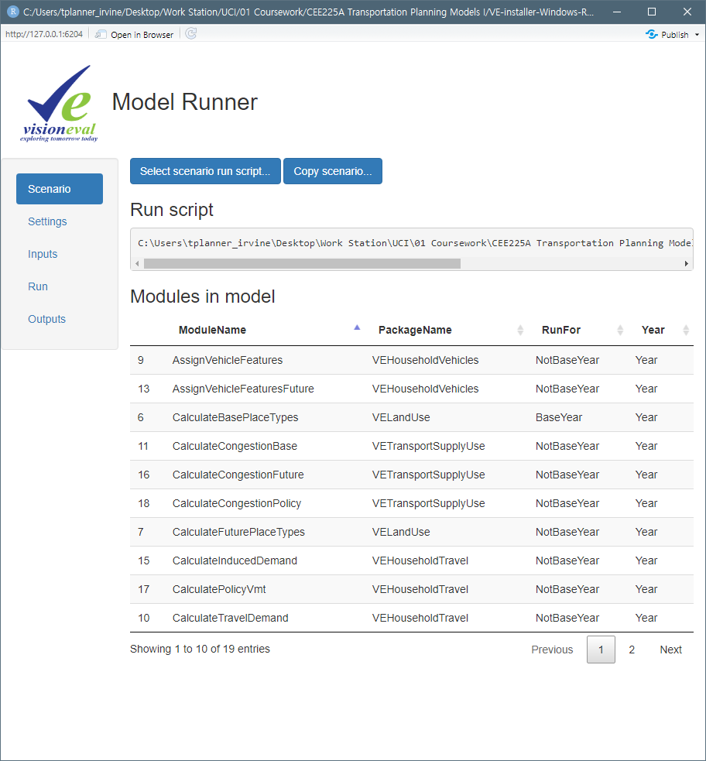
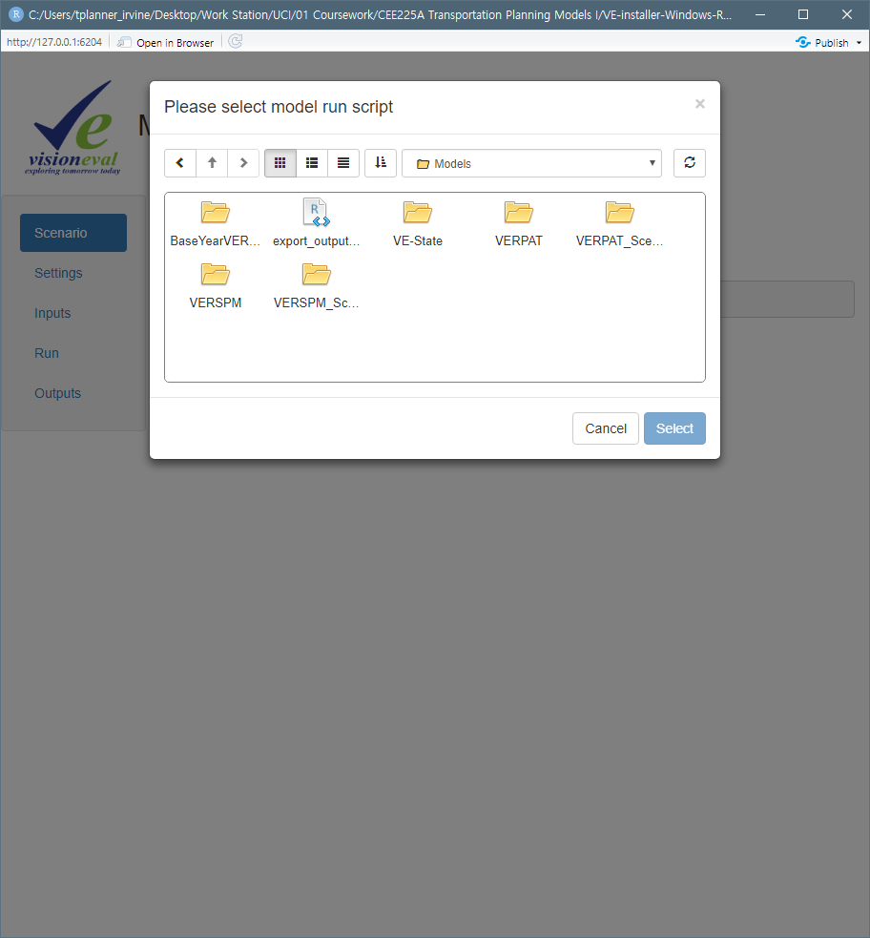
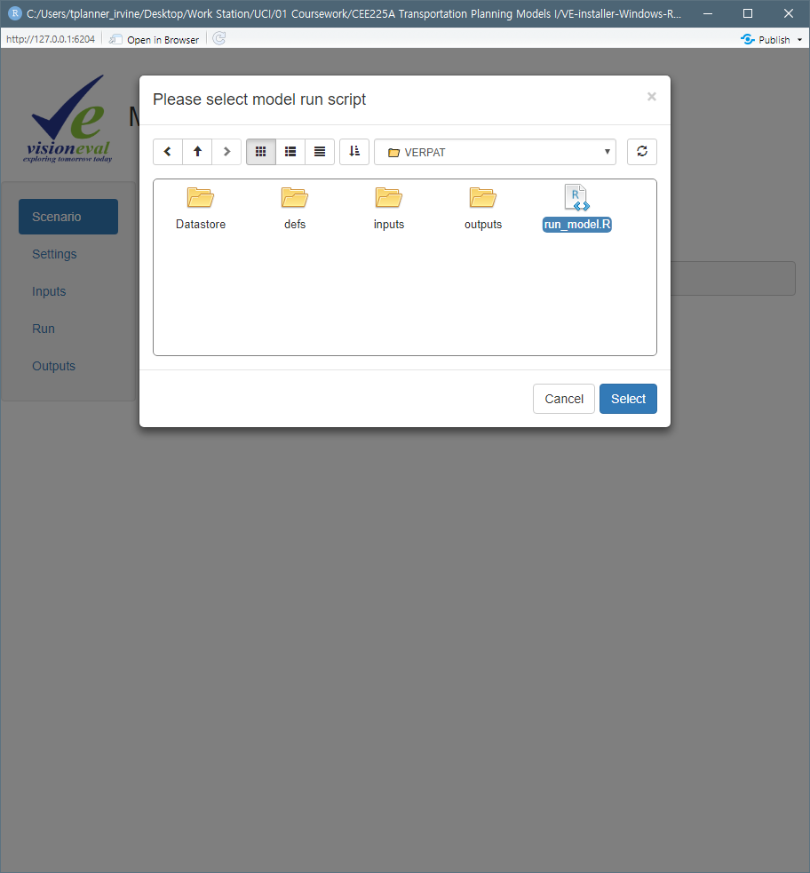
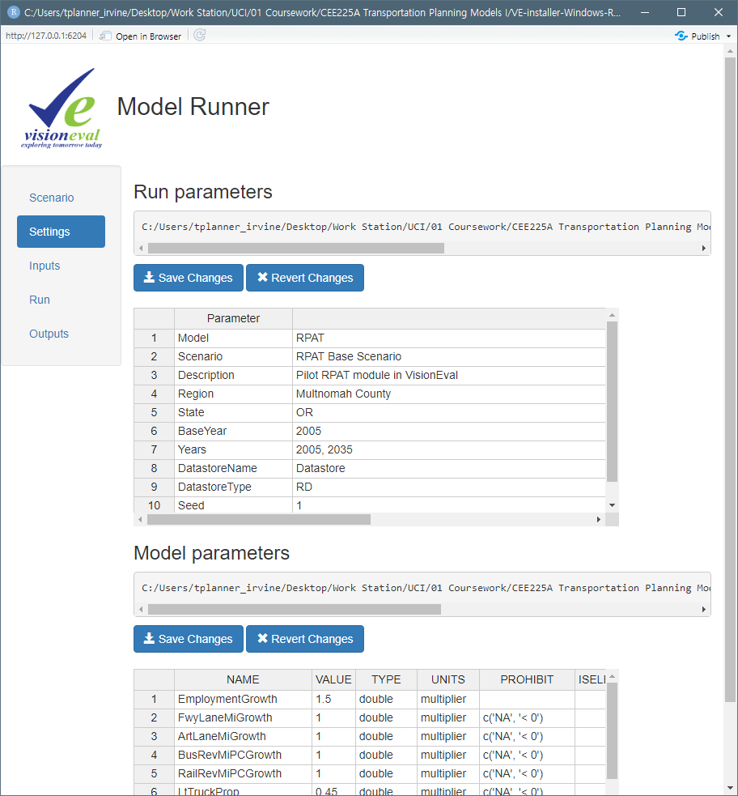
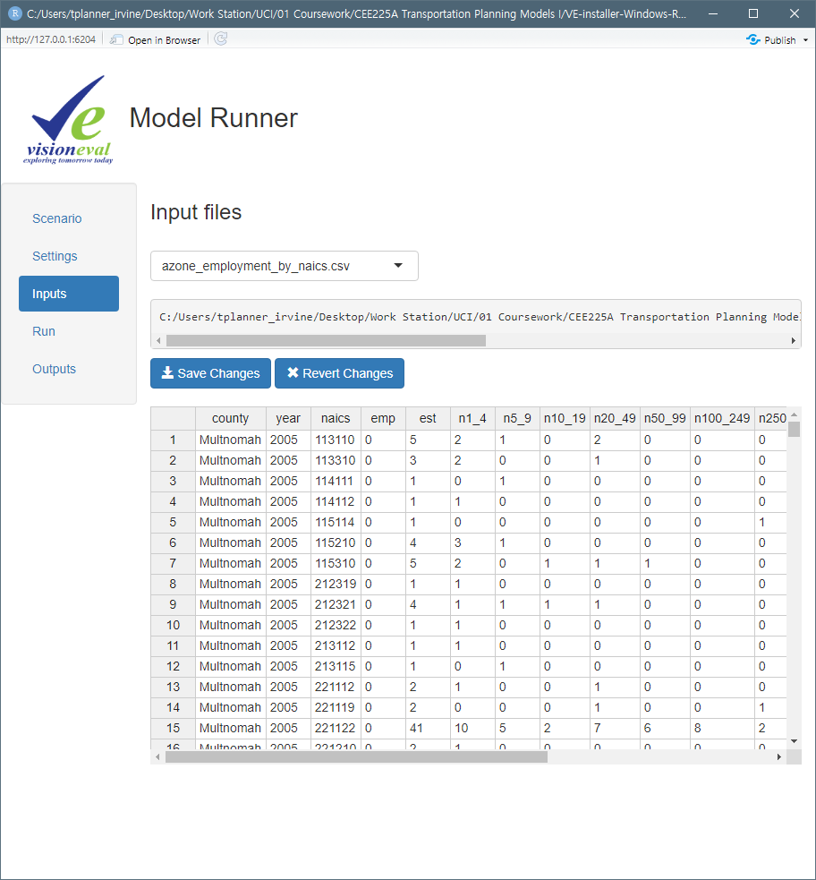
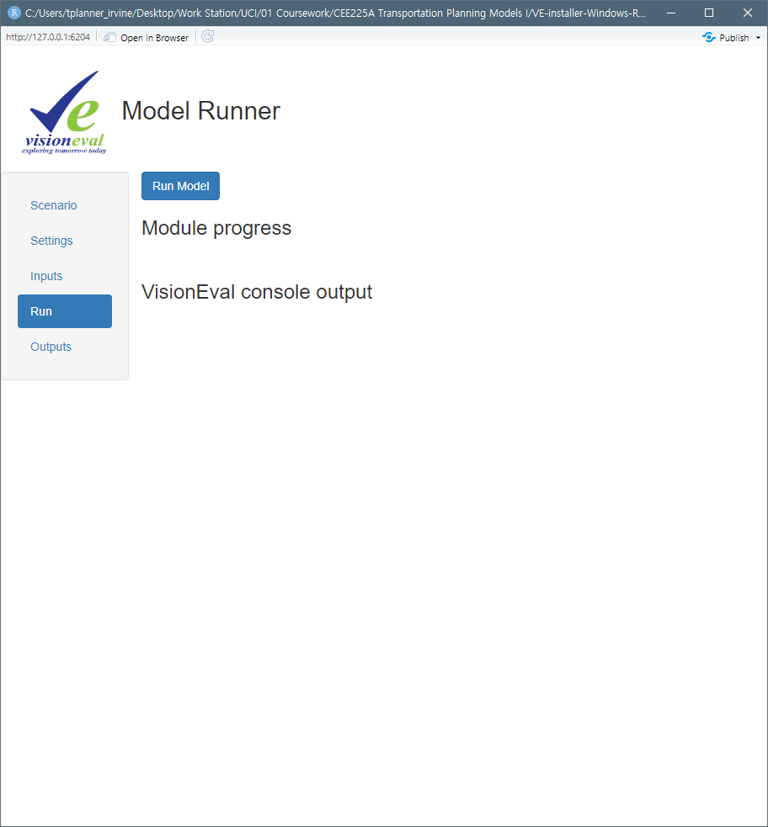
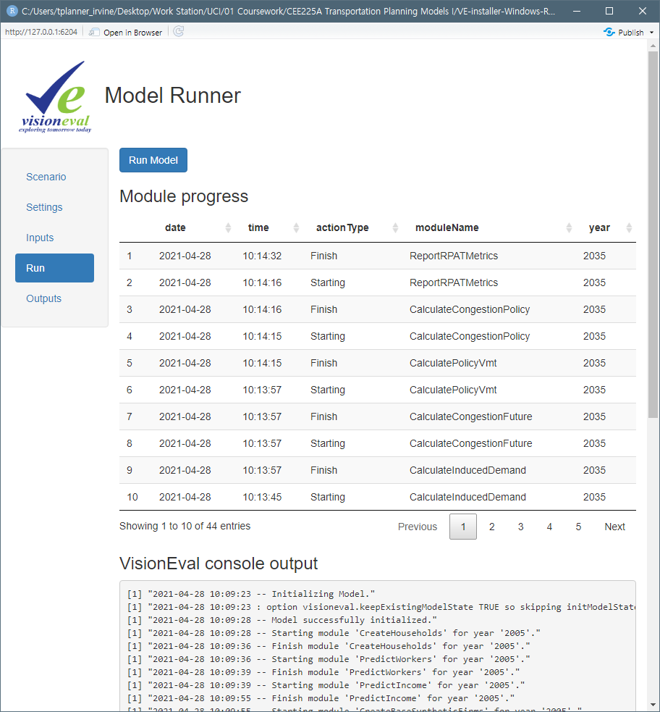
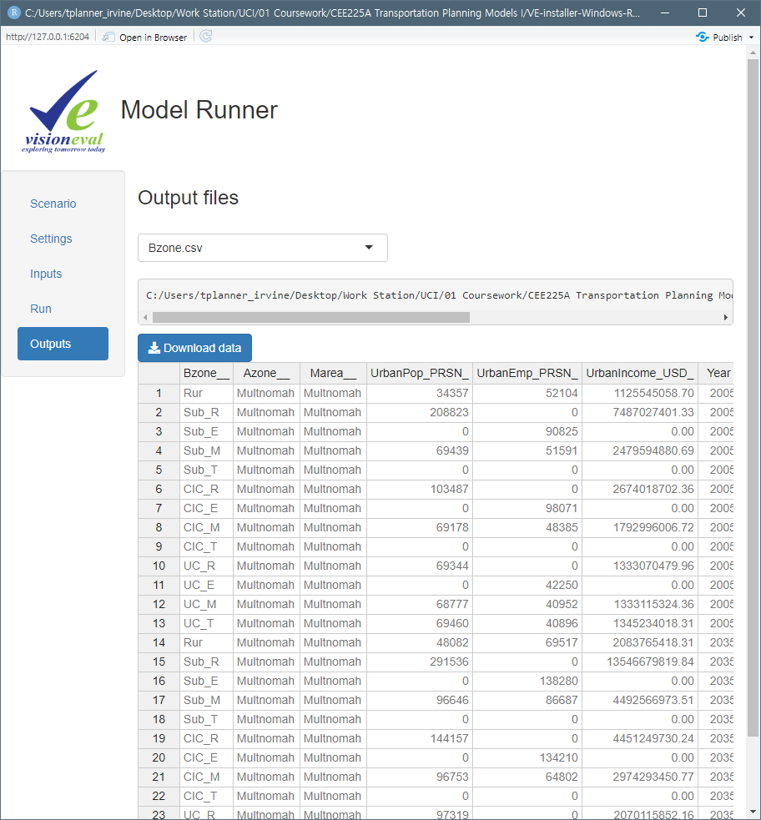
How to Run Inside the VEGUI
Open scenario
Open your Scenario
Change your parameters in Settings
Adjust csv input files in Input
Run the model in Run
See the results in Outputs
Select which input file to view / edit
Select output file to view
Click run_model.R
Select VERPAT
Information of base / target scenarios
Steps
JSON inputs
What the model will do
You can edit the values and save the changes here
|
Younghun Bahk
Notes:
First, you can see the window like this.

Slide 6
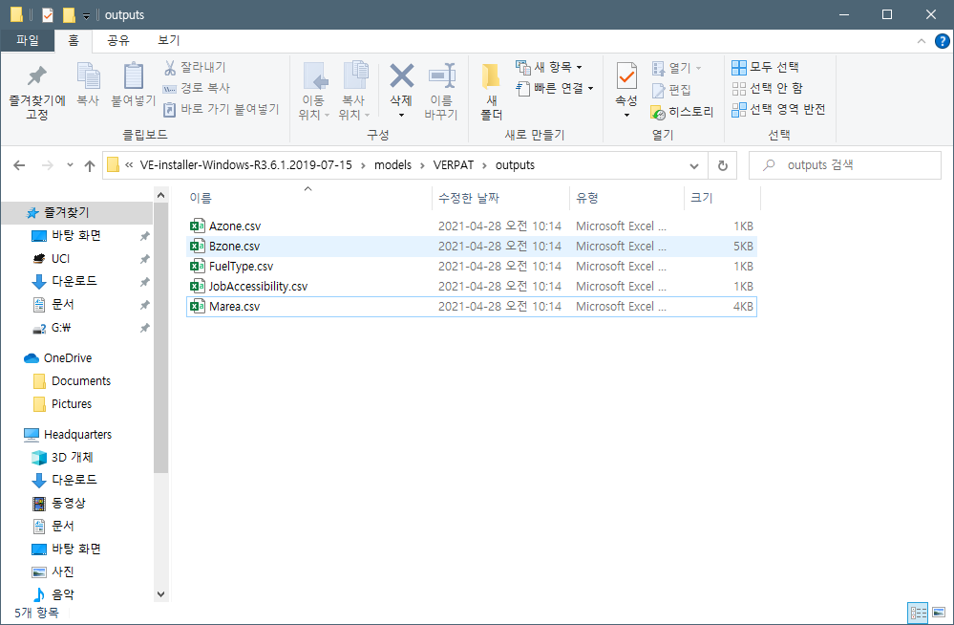
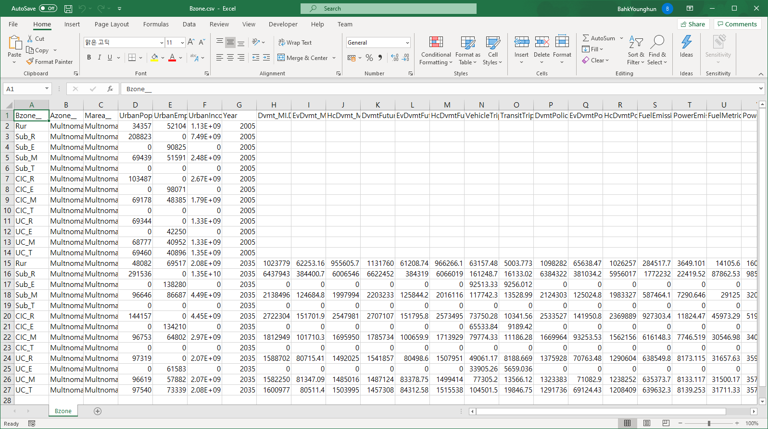
How to See the Outputs Outside the VEGUI
Find the VE folder and go into models\VERPAT\outputs
Open csv files to see the results
|
Younghun Bahk
Notes:
The output csv files are available outside the GUI as well.

Slide 7
Input Data Input Files to Change
There are five types of data to change for our project: 1) Built Environment; 2) Demand; 3) Transport Supply; 4) Policy; and 5) Model Parameters.
Built Environment (1)
bzone_pop_emp_prop.csv
Demand (11)
region_trips_per_cap.csv
azone_employment_by_naics.csv
azone_hh_pop_by_age.csv
azone_gq_pop_by_age.csv
azone_hhsize_targets.csv
azone_per_cap_inc.csv
azone_relative_employment.csv
region_truck_bus_vmt.csv
BaseLtVehDvmt
BaseFwyArtProp
EmploymentGrowth
Transport Supply (2)
marea_lane_miles.csv
marea_rev_miles_pc.csv
Policy (10)
region_commute_options.csv
azone_its_prop.csv
region_light_vehicles.csv
marea_parking_growth.csv
AutoCostGrowth
FwyLaneMiGrowth
ArtLaneMiGrowth
BusRevMiPCGrowth
RailRevMiPCGrowth
VmtCharge
Model Parameters (27)
model_accident_rates.csv
model_fuel_prop_by_veh.csv
model_fuel_composition_prop.csv
model_fuel_co2.csv
model_place_type_elasticities.csv
model_lace_type_relative_values.csv
model_tdm_ridesharing.csv
model_tdm_transit.csv
model_tdm_transitlevels.csv
model_tdm_vanpooling.csv
model_tdm_workschedule.csv
model_tdm_workschedulelevels.csv
model_transportation_costs.csv
model_veh_mpg_by_year.csv
model_phev_range_prop_mpg_mpkwh.csv
model_hev_prop_mpg.csv
model_ev_range_prop_mpkwh.csv
AnnVmtInflator
BaseCostPerMile
DvmtBudgetProp
FuelCost
KwhCost
GasTax
LtTruckProp
TranRevMiAdjFactor
TruckVmtGrowthMultiplier
WorkVmtProp
|
Younghun Bahk
Notes:
So far, we just saw how the VERPAT runs with the GUI.
But we have to modify the input files to run our own project.
Here is the list of input data for VERPAT.
There are five types of data and each type has several csv and JSON inputs.
The file that has no “.csv”, is JSON input. You can edit them inside the VE-GUI.

Slide 8
Input Data Built Environment (Land-use scenarios)
Close in Community
⑥
⑦
Suburban
Employment
Transit Oriented Development (TOD)
Urban Core
Close in Community
Rural
Residential
Mixed-Use
⑨⑩⑪⑫
⑦
③⑦⑪
①⑤⑨
①②③④
⑬
②⑥⑩
⑤⑥⑦⑧
⑥
④⑧⑫
⑤
There are 13 types of TAZ in VERPAT
According to the place, each TAZ can be either Urban Core areas (UC), Close in Community areas (CIC), Suburban areas (Sub), or Rural areas (Rur).
Each place type except rural area has four development types: Residential (R), Employment (E), Mixed Use (M), and Transit Oriented Development (T).
Urban Core
①
Rural
①
③
Suburban
⑬
Rural
Low level integration of housing with jobs, retail, and services
Poorly connected street networks
Low levels of transit service
Limited pedestrian facilities
High-density mixed use places
High job to housing ratios
Well connected streets
High levels of pedestrian activity
Primarily housing
Some mixed use centers and arterial corridors
Adjacent to downtown areas
Widely dispersed towns and residential uses
Little or no transit
Limited pedestrian facilities
Primiarily housing
Limited employment and retail opportunities
All place types except rural
Focused on employment
Limited retail and residential
All place types except rural
Mix of residential, commercial, and retail uses
Found in Close in Communities and Urban Core place types
Greater access to transit
All place types except rural
⑦
②
③
⑦
⑬
⑤
③
④
⑪
⑩
⑨
⑧
⑩
⑨
⑫
 | Urban Core | Close in Community | Suburban | Rural
Residential | ① | ⑤ | ⑨
Employment | ② | ⑥ | ⑩
Mixed-use | ③ | ⑦ | ⑪
Transit oriented development | ④ | ⑧ | ⑫
Rural |  |  |  | ⑬
|
Younghun Bahk
Notes:
The first input type is the Built Environment.
Before reading the input data, let me show how VERPAT categorizes the TAZs in the model.
There are 13 types of land-use.
They divide into four place types which are Urban Core, Close in Community, Suburban, and Rural.
Each place type, except the Rural, has 4 types of development, which are Residential, employment, mixed-use, and transit-oriented development.
Including the rural, which is the only one type for rural areas, we have 13 types of TAZs now.

Slide 9
Input Data Built Environment (Land-use scenarios)
Input file: bzone_pop_emp_prop.csv
Population and jobs by place type: The distribution of population and employment among the 13 place types for base and future year.
Each column, for each year, must sum to 1.
It is acceptable to have no land use (0) in certain categories.
Geo | Year | Pop | Emp
Rur | 2005 | 0.05 | 0.1
Sub_R | 2005 | 0.3 | 0
Sub_E | 2005 | 0 | 0.2
Sub_T | 2005 | 0 | 0
CIC_R | 2005 | 0.15 | 0
CIC_E | 2005 | 0 | 0.2
︙ | ︙ | ︙ | ︙
UC_E | 2035 | 0 | 0.1
UC_M | 2035 | 0.1 | 0.1
UC_T | 2035 | 0.1 | 0.1
|
Younghun Bahk
Notes:
Remember that the geographic input is not applicable here.
But instead, we have data of the proportion of each type.
We can change the proportions for each year, I mean base year and target year, keeping the sum to 1 for each year.

Slide 10
Input Data Travel Demand
Input file: region_trips_per_cap.csv
Auto and transit trips per capita: Regional averages for auto and transit trips per capita per day for the base year.
Auto: The regional average of auto trips per capita, including drive alone and shared ride travel. (NHTS)
Transit: The regional average of transit trips per capita, including walk and drive access to transit. (NTD)
Mode | Trips
Auto | 3.2
Transit | 0.4
|
Younghun Bahk
Notes:
Let’s see some other input files.
This shows “auto and transit trips per capita.” The data are basically based on the National Household Travel Survey and the National Transit Database.
You can see the data is very simple. Because this data is consistent with any types of land-use.

Slide 11
Input Data Travel Demand
Input file: azone_employment_by_naics.csv
Employment: Employment data for each county. (County Business Pattern data, CBP)
naics: North American Industrial Classification Systems
n1_4: 1–4 employees
…
n500_999: 500–999 employees
n1000_1: 1,000–1,499 employees
…
n1000_4: Over 5,000 employees
emp: Total number of employees
est: Total number of establishments
county | year | naics | emp | est | n1_4 | n5_9
Multnomah | 2005 | 113110 | 0 | 5 | 2 | 1
Multnomah | 2005 | 113310 | 0 | 3 | 2 | 0
Multnomah | 2005 | 114111 | 0 | 1 | 0 | 1
Multnomah | 2005 | 114112 | 0 | 1 | 1 | 0
Multnomah | 2005 | 115114 | 0 | 1 | 0 | 0
Multnomah | 2005 | 115210 | 0 | 4 | 3 | 1
Multnomah | 2005 | 115310 | 0 | 5 | 2 | 0
Multnomah | 2005 | 212319 | 0 | 1 | 1 | 0
Multnomah | 2005 | 212321 | 0 | 4 | 1 | 1
|
Younghun Bahk
Notes:
Another example is employment.
We can put the regional-level data of employment here.
According to the classification by NAICS, we can put the number of establishments by the number of employees.

Slide 12
Input Data Transport Supply
Input file: marea_lane_miles.csv
Road lane miles: The amount of transportation supply by base year in terms of lane miles of freeways and arterial roadways in the region.
Geo | Year | FwyLaneMi | ArtLaneMi
Multnomah | 2005 | 250 | 900
Multnomah | 2035 | 250 | 900
|
Younghun Bahk
Notes:
Now let’s see an example of supply side data.
Road lane miles are how long roads the region has and will have.
The sample shows there are 250 lane-miles of freeway and 900 lane-miles of arterial in Multnomah County.

Slide 13
Input Data Policy
Input file: marea_parking_growth.csv
Increase in parking cost and supply
PropWorkParking: proportion of employees that park at work
PropWorkCharged: proportion of employers that charge for parking
PropCashOut: proportion of employment parking that is converted from being free to pay under a “cash-out buy-back” type of program
PropOtherCharged: proportion of other parking that is not free
ParkingCost.2000: average daily parking cost in 2000 year USD. (just replace 2000 when we use)
Geo | Year | PropWorkParking | PropWorkCharged
Multnomah | 2005 | 1 | 0.1
Multnomah | 2035 | 1 | 0.1
|
Younghun Bahk
Notes:
For policy data, there are many data like commute options the policy provides, the proportion of light vehicles, and so on.
This one shows the parking proportions of employees and parking cost types in the region.

Slide 14
Input Data Model Parameters
Input file: model_accident_rates.csv
Accident Rates: Road safety impacts are calculated by factoring the amount of VMT.
National average rates from the Fatality Analysis Reporting System General Estimates System (2009) by USDOT.
Fatal: 1.14 per 100M Miles Traveled
Injury: 51.35 per 100M Miles Traveled
Property damage: 133.95 per 100M Miles Traveled
Accident | Rate
Fatal | 1.14
Injury | 51.35
Property | 133.95
|
Younghun Bahk
Notes:
The other things that can be changed, would be model parameters, such as accident rates and fuel consumptions.

Slide 15
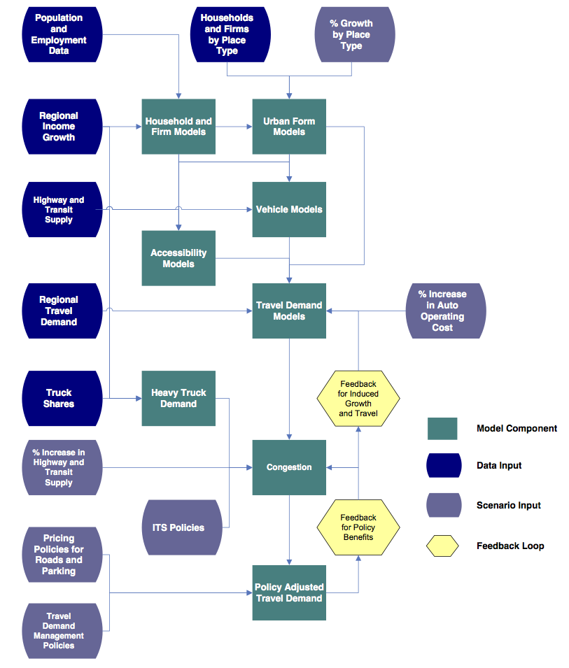
RPAT Process VERPAT as a Disaggregate Policy Model
VERPAT predicts travel demand impacts at an individual household level.
|
Younghun Bahk
Notes:
The whole RPAT process can be seen in one picture they provided.
This is how it runs inside the model.
Briefly we can find what data they use and which models are implemented and which are following.
For example, from the population and employment data, it runs household and firm models and then runs other models with additional data.
The flowchart shows that it finally provides the travel demand by the implementation of the policy with some feedback loops.

Slide 16
What We Get from RPAT Scenario Evaluations
Travel Impacts
Daily VMT
Daily vehicle trips
Daily transit trips
Average travel speeds by vehicle type
Vehicle hours of travel and vehicle hours of delay
Environmental and Energy Impacts
Fuel consumption
Greenhouse gas emissions
Financial and Economic Impacts
Regional highway infrastructure costs
Regional transit infrastructure and operating costs
Annual traveler cost, including fuel cost, fuel tax, parking cost and VMT charges
Location Impacts
Regional accessibility based on place types
Community Impacts
Accidents, walking percentage increase, Job accessibility by income group
|
Younghun Bahk
Notes:
To summarize, what we finally get from VERPAT can be listed as below.
Some data only provide a single regional-level output value, and the others provide different values by TAZ, traffic analysis zone.

Slide 17
CEE225A presentation part II Models and Data Preparation for VERPAT
Xiangyu Li

Slide 18
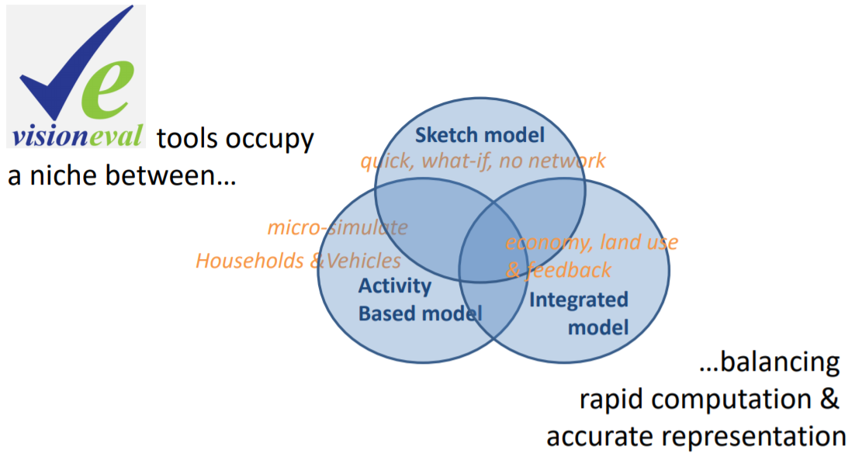
Content
Objectives of the software (a brief review)
Models
Packages and modules
Data
Case study: Reducing GHG and Planning for the
Regional Land Use Vision, the Albany (NYDOT)
Xiangyu Li
Notes:
A quick review of VERPAT (VisionEval Rapid Policy Analysis Tool), the tool was developed to help planners evaluate the potential effect of growth policies on regional travel in a metropolitan area. Unlike the traditional sketch planning model or strategic planning model, VERPAT maintain a balance between details and simplicity. The 2nd part of this presentation will focus on the following sections: objectives, models, packages, data requirement and a case study done by NYDOT. A unique advantage of VERPAT is it use high-level geography (13 types of generally defined TAZs in this case) rather than a network, it can rapidly evaluate multiple alternative scenarios. This capability helps planners and policy makers understand likely outcomes of different policy choices.

Slide 19
Objectives of the software (review)
Evaluate policy scenarios to identify the most promising policies that could be further tested using a more detailed project level tool
Provide information on the following changes in the regional system
Built environment (e.g., % of population living in different land uses)
Travel demand (e.g., changes in relation to demographics, firm size, induced
demand)
Transportation supply (e.g., transit services, freeway/arterial capacity)
Policies (e.g., pricing, ITS, demand management)
For regional planning
Xiangyu Li
Notes:
Th objectives of VERPAT is to evaluate policy scenarios to identify the most promising policies that could be further tested using a more detailed project level tool (activity-based, network-based or integrated models). VERPAT provides information on the following changes a regional systems given an input scenario. Built environment, travel demand, transportation supply and certain types of policy outcomes.
Specifically,
•Built Environment - changes to the urban form (proportion of population and employment living in mixed-use areas, transit-oriented developments, or rural/greenfield areas)
•Travel Demand - changes in population demographics (age structure), changes in personal income, changes in firms by size or industry, relative amounts of development occurring in urban core, close-in communities, suburban or rural areas, urban core, auto and light truck proportions by year, and induced demand
•Transportation Supply - amounts of regional transit service, amounts of freeway and arterial capacity
•Policies - pricing (vehicle miles traveled charges or parking pricing programs), intelligent transportation system (ITS) strategies for freeways and arterials, demand management (vanpool, telecommuting, ridesharing, and transit pass programs)

Slide 20
How It Works Anaylsis Procedure
3
5
1
Base year data
Factors
Target year data (external)
Population
By age
Trips per captita
by mode
Population (and HH)
Household and firm model
Land-use
By income
Employment
# of employees
2
Avg car ownership
by income, age
Lane miles
Calibration
Vehicle model
︙
VMT rate
6
Land-use
13 types
Travel demand model
Urban form model
Target year prediction
︙
8
Car ownership
By age
By income
4
7
Models
VMT
Feedback
VMT
By firm
By household
Household and firm model
Avg speed
Demand feedback
Lane miles
Urban form model
GHG emission
Induced demand model
Accessibility model
Accessibility model
Supply feedback
Vehicle model
Daily trips
Policy adjusted travel demand
Avg speed
By VMT
Congestion model
Travel demand model
By lane miles
︙
︙
Congestion model
20
|
Younghun Bahk
Notes:
A review of a previous slide (analytical flow of the VERPAT).

Slide 21
Model components
Baseline
Household and firm model
Urban form model
Accessibility model
Vehicle model
Travel demand model
Congestion model
Feedback loops
Induced demand model
Policy adjusted travel demand
Performance metrics
Xiangyu Li
Notes:
VERPAT provides six baseline models and three models as part of its feedback loops.
1. Household Model creates synthetic households for the region, including persons and workers by age group. A total household income is assigned to each household, given the ages of persons in the household and the average per capita income of the region where the household resides.
2. Firm Model creates a set of firms for each forecast year that represents the likely firm composition for the region, given the County Business Pattern data of firms by size and industry. Each firm is described in terms of the number of employees and its industry.
3. Urban Form Model calculate Place Types for Households and Firms. Defined by VERPAT, there are four place types (urban core, Close-in Community, suburban, and rural and five location categories (residential, commercial, mixed-use, transit-oriented development, and Greenfield)]. Models for households were developed to estimate location characteristics using National Household Travel Survey data. Firms are currently allocated randomly to fit the employment allocation inputs since there are no national datasets from which to draw these relationships.
4. Accessibility Model calculate Freeway, Arterial, and Public Transit Supply Levels - The number of lane miles of freeways and arterials is computed for each region based on the change in inventories for a particular scenario. For public transit, the inputs specify the change in transit revenue miles relative to the base. Inputs for each area also specify the revenue mile split between electrified rail and buses.
5. Vehicle Model calculates Vehicle Ownership - Each household is assigned the number of vehicles it is likely to own based on the number of persons of driving age in the household, whether only elderly persons live in the household, the income of the household, the population density where the household lives, the freeway supply, the transit supply, and whether the household is located in an urban mixed-use area.
6. Travel Demand Model calculates Travel Demand - The average daily vehicle miles traveled, classification of vehicles as electric vehicles, auto and transit trips for each household is modeled based on household information determined in previous steps for the base conditions. The model is sensitive to household income, population density of the neighborhood where the household resides, number of household vehicles, whether the household owns no vehicles, the levels of public transportation and freeway supplies in the region, the driving age population in the household, the presence of persons over age 65, and whether the neighborhood is characterized by mixed-use development.
7. Congestion Model calculates the amount of congestion – Auto, and light truck VMT, truck VMT and bus VMT are allocated to freeways, arterials, and other roadways. Truck and bus VMT are allocated based on mode-specific data, and auto and light truck VMT are allocated based on a combination of factors and a model that is sensitive to the relative supplies of freeway and arterial lane miles. System-wide ratios of VMT to lane miles for freeways and arterials are used to allocate VMT to congestion levels using congestion levels defined by the Texas Transportation Institute for the Urban Mobility Report. Each freeway and arterial congestion level is associated with an average trip speed for conditions that do and do not include ITS treatment for incident management on the roadway. Overall average speeds by congestion level are calculated based on input assumptions about the degree of incident management. Speed vs. fuel efficiency relationships for light vehicles, trucks, and buses are used to adjust the fleet fuel efficiency averages computed for the region.
In the feedback loops, there are Induced Demand Model and policy adjusted travel demand model.
The induced demand model calculates changes in roadway supply in the near term as a function of speed, based on potential mode and route shifts to produce changes in VMT and in the longer term to include changes in vehicle ownership, still as a function of speed. This model does not include induced demand as a result of changes in growth that may occur as part of a smart growth scenario because the evidence is limited empirical evidence.
Policy Adjusted Travel Demand calculates Scenario Travel Demand - The average daily VMT for each household can be adjusted based on changes in growth patterns by place type, changes in auto operating cost, changes in road lane miles or transit revenue miles for any scenario. There are also a series of policy assumptions that can contribute to changes in VMT: pricing such as VMT charges or parking pricing, ITS strategies for freeways and arterials, and vanpool, telecommuting, ridesharing, and transit pass programs. All of these will contribute to shifts in travel demand for a given scenario.

Slide 22
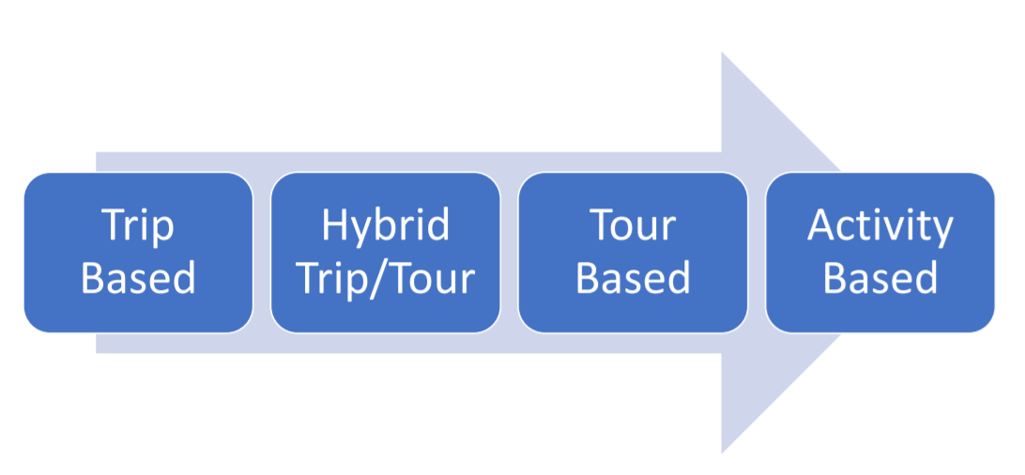
Alternative travel demand models
Xiangyu Li
Notes:
Unfortunately, VERPAT does not provide any information related to the specific algorithms or even functions used in the model. We did a comprehensive search of the entire VERPAT GitHub websites, technical documents, and case studies done by several MPOs. Given that VERPAT was developed by staff members of several DOTs, the publications of the developers are scarce. But based on the model description and running time, we guess that the travel demand model of VERPAT might be a sketchy trip-based model.

Slide 23
Packages and modules
CreateHouseholds
PredictWorkers
PredictIncome
VEHouseholdVehicles
VehicleFeatures
VehicleFeaturesFutrue
VESimHouseholds
TravelDemand
TravelDemandFutrue
InducedDemand
PolicyVMT
BaseFirms
FutrueFirms
VEHouseholdTravel
VESyntheticFirms
BasePlaceTypes
FutruePlaceTypes
CongestionBase
CongestionFuture
VELandUse
VETransportSupplyUse
BaseAccessibility
FutrueAccessibility
VETransportSupply
VEReports
ReportRPATMetrics
Xiangyu Li
Notes:
Corresponding packages under each model. Base year estimation and future year-to-year estimation.

Slide 24
Data preparation for the project
Option 1: Generating hypothetical scenarios with the sample data
Option 2: Build our own dataset
Xiangyu Li
Notes:
Running VERPAT for regional planning requires 16 different datasets and 9 parameter files. The scenario inputs contain four categories: built environment, demand, transport supply, and policy. These inputs are specified in two ways. CSV inputs are specified in a .csv file and JavaScript Object Notation (JSON) inputs are specified in the model_parameters.json file. Some inputs, such as the csv file azone_gq_pop_by_age.csv or the czone locations, are not used in VERPAT, but they are required for the VisionEval framework.

Slide 25
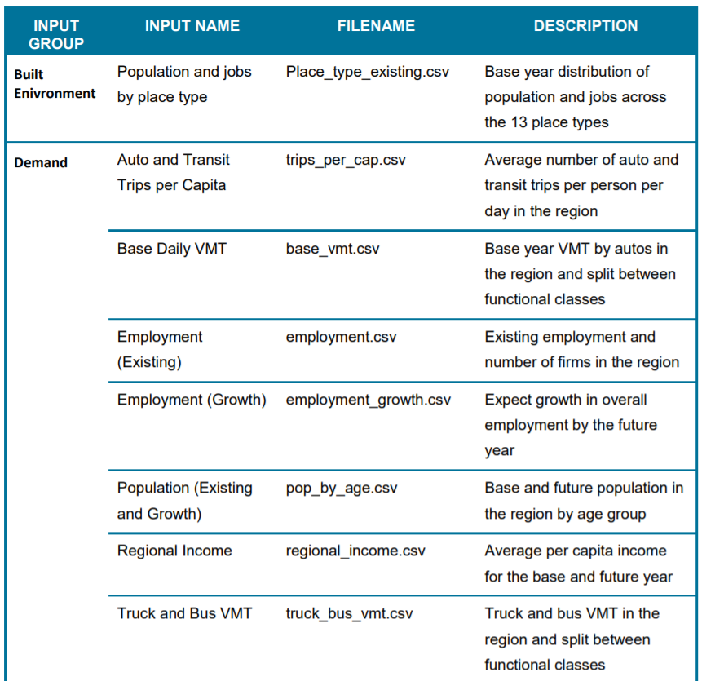
Baseline inputs
Xiangyu Li
Notes:
Please see the table for the description of input files and datasets.

Slide 26
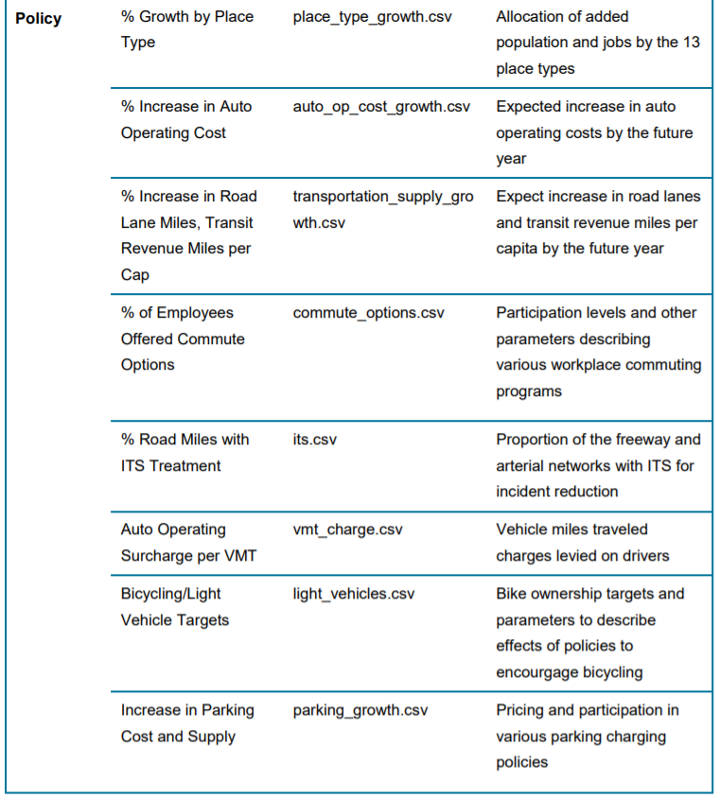
Policy inputs
Xiangyu Li
Notes:
Continue table.

Slide 27
Potential data sources
Built environment inputs
MPO land use database
ACS (population and employment)
Travel demand inputs
National Household Travel Survey
National Transit Database
Highway Performance Monitoring system
ACS (Business)
US consumer price index
Xiangyu Li

Slide 28
Potential data sources
Travel supply inputs
Federal Highway Administration’s Highway Statistics Data
National Transit Database
Policy inputs (highly-uncertain)
Other simulation tools
Comparative estimation
Environmental impact report (EIR)
Xiangyu Li
Notes:
By reviewing the input datasets, we realized that significant uncertainties might be generated from policy inputs. Thus, we recommend in practice, we may use other simulation tools to accuratedly translate policy input into model parameters. Or using other case study to generate similar parameters. Potential data sources can be fetched from EIR.

Slide 29
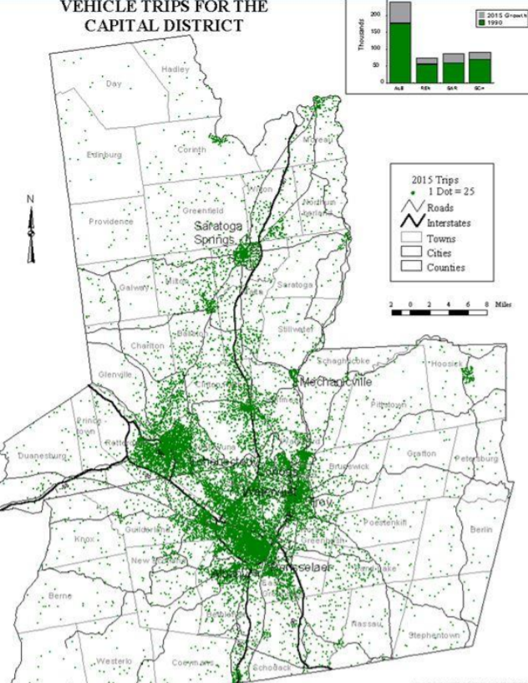
Case study
CDTC is the designated MPO for the Albany Schenectady-Troy and Saratoga metropolitan areas.
Four counties,
Eight Cities
850,000 Population
Xiangyu Li

Slide 30
Scenarios tested with VERPAT
Trend land use and development patterns
Connected and Automated Vehicle technologies: encourage development further from urbanized areas and increased sprawl development patterns
Mobility as a Service and CAV technologies and urban reinvestment make the cities more attractive, encouraging transit-oriented development in urbanized areas
CDTC, State and federal investments and policies lead to accelerating use of electric vehicles beyond trend
Energy Plan goals
Explore pricing options, such as a carbon tax
Xiangyu Li

Slide 31
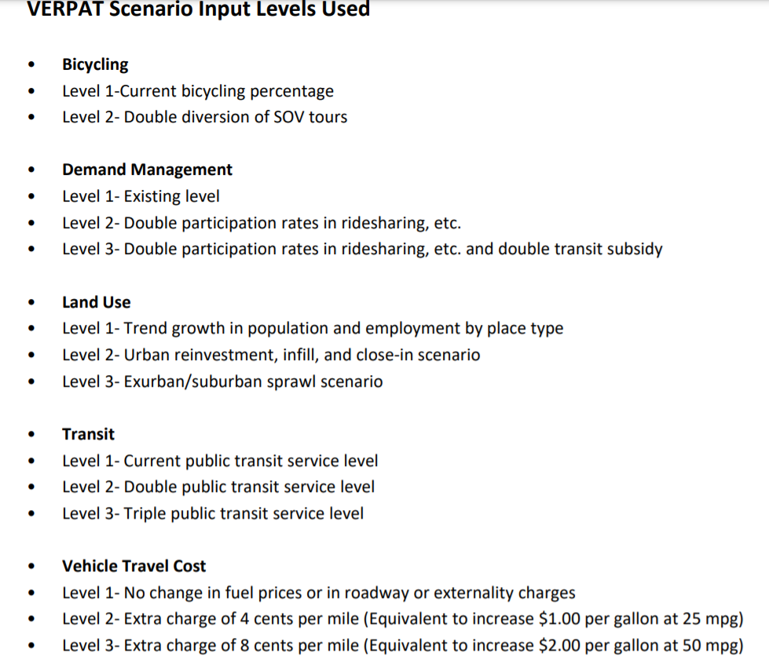
2*3^4=162 scenarios
Xiangyu Li

Slide 32
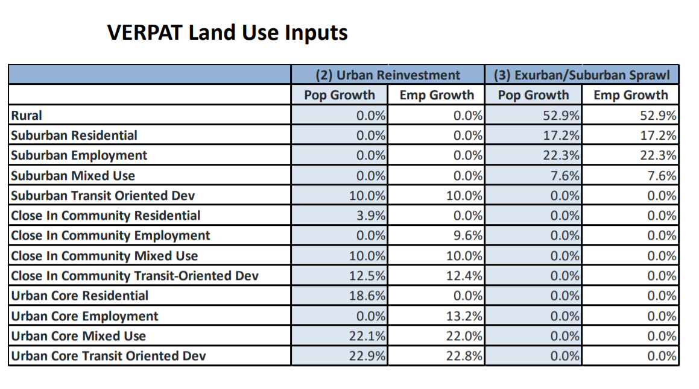
Xiangyu Li

Slide 33
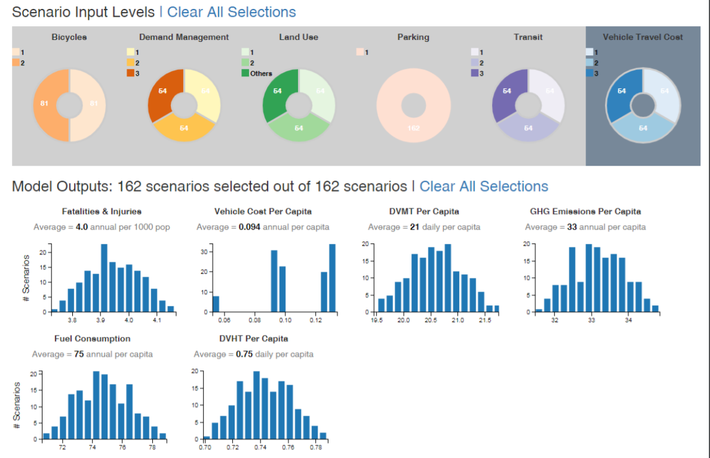
Xiangyu Li

Slide 34
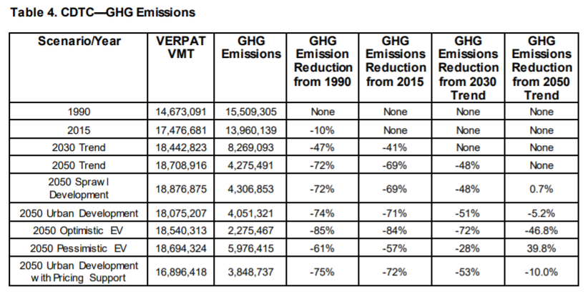
Xiangyu Li

Slide 35
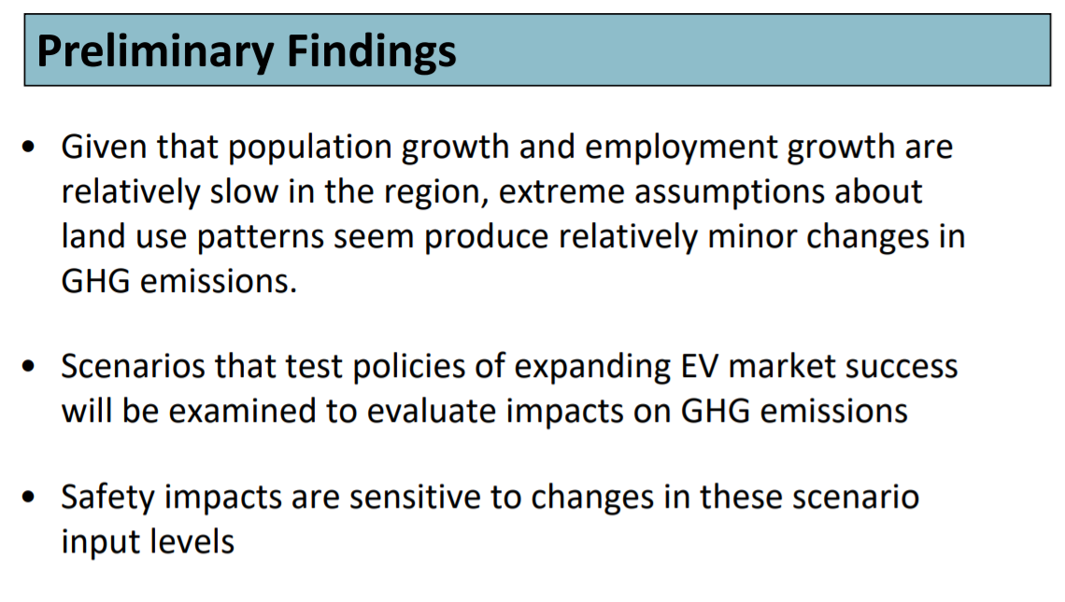
Xiangyu Li

Slide 36
What’s next
Generating hypothetical scenarios based on the sample
datasets
Replacing some input datasets
Xiangyu Li

Slide 37
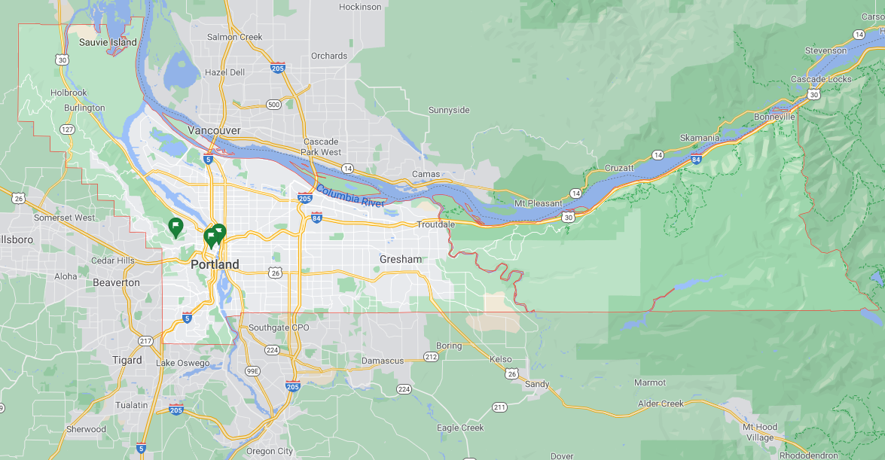
Case Study and Scenario Definition
Study Region and Timelines:
Multnomah County, Oregon
Base Year = 2005 and Future Year = 2035
Notes:
Our analysis will be made on the region of Multnomah County, OR which includes the main city of Portland as well as an extension of East and Northwest of the city.
The timeline of the study is expanded from 2005 as the base year, and future year of 2035, leading into a planning horizon of 30 years.

Slide 38
Case Study and Scenario Definition
Planning Scenarios Considered:
Bicycles:
Diversion of SOV travels to bicycles, electric bicycles and other light-weight vehicles.
Demand Management:
Programs and incentives which encourage people to drive less including ridesharing,
van pooling, telecommuting, and transit subsidies.
3. Land Use:
The form in which development occurs (density, regional accessibility, mixed use, etc.) represented by the distribution of population and employment by place type.
Parking:
The extent of paid parking and its price
Transit:
The extent and frequency of transit service
Vehicle Travel Cost:
The combination of fuel prices and vehicle travel charges to pay for roadways and
to pay for externalities such as carbon pricing
Notes:
In the planning process of VERPAT, there are 6 sub-categories to decide on. Many factors affect light duty vehicle travel. Because the number of factors considered is large, they were grouped into 6 categories as follows:
Bicycles: The diversion of single-occupant vehicle travel to bicycles, electric bicycles and other light-weight vehicles.
Demand Management: Programs and incentives which encourage people to drive less including ridesharing, van pooling, telecommuting, and transit subsidies.
Land Use: The form in which development occurs (density, regional accessibility, mixed use, etc.) represented by the distribution of population and employment by place type.
Parking: The extent of paid parking and its price.
Transit: The extent and frequency of transit service.
Vehicle Travel Cost: The combination of fuel prices and vehicle travel charges to pay for roadways and to pay for externalities such as carbon pricing.
We will be defining multiple policy parameters for each subcategory of planning scenario and provide a table showing the values in the next few slides.

Slide 39
Case Study and Scenario Definition
Planning Scenarios Considered:
Bicycles:
Diversion of SOV travels to bicycles, electric bicycles and other light-weight vehicles.
Demand Management:
Programs and incentives which encourage people to drive less including ridesharing,
van pooling, telecommuting, and transit subsidies.
3. Land Use:
The form in which development occurs (density, regional accessibility, mixed use, etc.) represented by the distribution of population and employment by place type.
Parking:
The extent of paid parking and its price
Transit:
The extent and frequency of transit service
Vehicle Travel Cost:
The combination of fuel prices and vehicle travel charges to pay for roadways and
to pay for externalities such as carbon pricing
Parameter | Current Condition | New Policy I
Non-motorized vehicle ownership rate | 0.2 | 0.4
The upper limit for SOV tour lengths suitable for reallocation to non-motorized modes (miles) | 2 | 2
The proportion of SOV tours within the mileage threshold for which non-motorized vehicles might be substituted | 0.1 | 0.2
Notes:
This table contains input data for the non-motorized vehicle model. In VERPAT, non-motorized vehicles are bicycles, and electric bicycles, segways, and similar vehicles that are small, light-weight and can travel at bicycle speeds or slightly higher. The parameters are as follows.
The core concept of the model is that non-motorized vehicle usage will primarily be a substitute for short-distance SOV travel. Therefore, the model estimates the proportion of the household vehicle travel that occurs in short-distance SOV tours. The model determines the maximum potential for household VMT to be diverted to non-motorized vehicles, which is also dependent on the availability of non-motorized vehicles. Note that bike share programs (BSP) serve to increase the availability of non-motorized vehicles.

Slide 40
Case Study and Scenario Definition
Planning Scenarios Considered:
2. Demand Management:
Programs and incentives which encourage people to drive less including ridesharing,
van pooling, telecommuting, and transit subsidies.
Parameter | Current Condition | New Policy I | New Policy II
Ridesharing Participation | 0.05 | 0.01 | 0.1
Transit Subsidy Participation | 0.1 | 0.2 | 0.2
Transit Subsidy Level (in Dollars) | 1.25 | 1.25 | 2.5
Work 4 days every other week averaging 80 hours over 2 weeks | 0.01 | 0.02 | 0.02
Work Schedule with 4 days per week with 40 hours per week | 0.01 | 0.02 | 0.02
Work Schedule with workers may work 1-2 days/week remotely | 0.01 | 0.02 | 0.02
High Participation of employees in Van Pooling | 0.04 | 0.08 | 0.08
Moderate Participation of employees in Van Pooling | 0.02 | 0.04 | 0.04
Low Participation of employees in Van Pooling | 0.01 | 0.02 | 0.02
Notes:
This table contains assumptions about the availability and participation in work-based travel demand management programs. The policies are ridesharing programs, transit pass programs, telecommuting or alternative work schedule programs, and vanpool programs. For each, the user enters the proportion of workers who participate (the data items with the “Participation” suffix). For one program, the transit subsidy, the user must also enter the subsidy level in dollars for the TransitSubsidyLevel data item. Here is a snapshot of the table including parameters and their values in each policy.

Slide 41
Case Study and Scenario Definition
Planning Scenarios Considered:
3. Land Use:
The form in which development occurs (density, regional accessibility, mixed use, etc.) represented by the distribution of population and employment by place type.
Major Land Use | Geography | Current Condition |  |  |  | New Policy I
 |  | 2005 |  | 2035 |  | 2005 |  | 2035
 |  | Population | Employment | Population | Employment | Population | Employment | Population | Employment
Rural | - | 0.05 | 0.1 | 0.05 | 0.1 | 0.05 | 0.1 | 0.05 | 0.1
Transit-oriented Development | Urban Core | 0.1 | 0.1 | 0.1 | 0.1 | 0.1 | 0.1 | 0.1 | 0.1
 | Close-in Community | 0 | 0 | 0 | 0 | 0 | 0 | 0 | 0
 | Suburban | 0 | 0 | 0 | 0 | 0 | 0 | 0 | 0
Mixed Use | Urban Core | 0.1 | 0.1 | 0.1 | 0.1 | 0.1 | 0.1 | 0.2 | 0.175
 | Close-in Community | 0.1 | 0.1 | 0.1 | 0.1 | 0.1 | 0.1 | 0.1 | 0.1
 | Suburban | 0.1 | 0.1 | 0.1 | 0.1 | 0.1 | 0.1 | 0.05 | 0.05
Commercial | Urban Core | 0 | 0.1 | 0 | 0.1 | 0 | 0.1 | 0 | 0.1375
 | Close-in Community | 0 | 0.2 | 0 | 0.2 | 0 | 0.2 | 0 | 0.2375
 | Suburban | 0 | 0.2 | 0 | 0.2 | 0 | 0.2 | 0 | 0.1
Residential | Urban Core | 0.1 | 0 | 0.1 | 0 | 0.1 | 0 | 0.15 | 0
 | Close-in Community | 0.15 | 0 | 0.15 | 0 | 0.15 | 0 | 0.2 | 0
 | Suburban | 0.3 | 0 | 0.3 | 0 | 0.3 | 0 | 0.15 | 0
Notes:
This table contains the distribution of population and employment among the 13 place types for base and future year. Each column, for each year, must sum to one. It is acceptable to have no land use (i.e. a value of 0) in certain categories.
The yearly TAZ employment and population totals were summed by the 13 place types and then scaled to total one for both employment and population. The allocation of growth between the base and the future years in population and employment to each of the 13 place types is captured by the rows containing future years. A similar approach can be used to allocate expected growth from spatial planning resources such as TAZ or Census Block Group level forecasts to the place types. Here is a snapshot of the table of land use proportions for each geography and major land use for the base case (no majoe change of proportions in 2035 compared to 2005) and policy 1 which includes a 5% increase in mixed use population density (and 5% reduction in population density of residential land use) as well as 2.5% increase in employment density of mixed use and 2.5% reduction of employment density in 2035 compared to 2005.

Slide 42
Case Study and Scenario Definition
Planning Scenarios Considered:
Parking:
The extent of paid parking and its price
Parameter | Current Condition |  | New Policy I |  | New Policy II
 | 2005 | 2035 | 2005 | 2035 | 2005 | 2035
Proportion of Employees parking at work | 1 | 1 | 1 | 1 | 1 | 1
Proportion of Employees that charge for parking | 0.1 | 0.1 | 0.12 | 0.12 | 0.12 | 0.12
Proportion of employment parking that is converted from being free to pay under a "cash-out buy-back" | 0 | 0 | 0 | 0 | 0 | 0
Proportion of other parking that is not free | 0.05 | 0.05 | 0.06 | 0.06 | 0.06 | 0.06
average daily parking cost (USD) | 5 | 5 | 5 | 5 | 10 | 10
Notes:
This file contains information that allows the effects of policies such as workplace parking charges and "cash-out buy-back" programs to be tested. The input parameters are as follows and should be entered for both the base and future year:
PropWorkParking: proportion of employees that park at work
PropWorkCharged: proportion of employers that charge for parking
PropCashOut: proportion of employment parking that is converted from being free to pay under a "cash-out buy-back" type of program
PropOtherCharged: proportion of other parking that is not free
ParkingCost.2000: average daily parking cost in 2000-year USD. In order to use base year dollars just replace 2000 in column labels with base year. This variable is the average daily parking cost for those who incur a fee to park. If the paid parking varies across the region, then the "PkgCost" value should reflect the average of those parking fees but weighted by the supply – so if most parking is in the Center City, then the average will be heavily weighted toward the price in the Center City. Policy 1 and 2 include a 20% increase in proportion of employees that are being charged for their parking, with the difference of average daily parking cost being doubled in policy 2 compared to base policy and policy 1.

Slide 43
Case Study and Scenario Definition
Planning Scenarios Considered:
5. Transit:
The extent and frequency of transit service supply
Vehicle Travel Cost:
The combination of fuel prices and vehicle travel charges to pay for roadways and
to pay for externalities such as carbon pricing
Parameter | Current Condition | New Policy I | New Policy II
Proportion increase in supply of freeways lane miles compared to Base Year | 1 | 2 | 3
Proportion increase in supply of arterial lane miles compared to Base Year | 1 | 2 | 3
Proportion increase in transit revenue miles per capita for bus | 1 | 2 | 3
Proportion increase in transit revenue miles per capita for rail | 1 | 2 | 3
Parameter | Current Condition | New Policy I | New Policy II
VMT Charging Rate ($/Mile) | 0.00 | 0.05 | 0.09
Notes:
This module calculates freeway, arterial, and public transit supply levels for all years using existing (base) data. The number of lane miles of freeways and arterials is computed for each region based on the change in inventories for a particular scenario. For public transit, the inputs specify the change in transit revenue miles relative to the base. Inputs for each area also specify the revenue mile split between electrified rail and buses
increase in supply of freeways lane miles: Ratio of urbanized area freeway and expressway lane-miles to urbanized area population. By default, the transportation supply is assumed to grow in line with population increase; therefore, a value of 1 indicates growth in proportion with population growth. A value less than 1 indicates that there will be less freeway lane mile supply, per person, in the future. A value of 1 indicates faster freeway expansion than population growth.
increase in supply of arterial lane miles: Ratio of urbanized area arterial lane-miles to urbanized area population. It is a similar value to freeway except that it measures arterial lane mile growth. It is also proportional to population growth.
Freeway and Arterial are total lane miles for those functional classes in the region. These data can be derived from the Federal Highway Administration’s (FHWA) Highway Statistics data
increase in transit revenues: Ratio of transit revenue miles per capita for rail and bus to urbanized area population. This encompasses all rail and bus modes, from light rail through to commuter rail. Bus and Rail are annual bus and rail revenue miles per capita for the region. These data can be derived from the National Transit Database, where the annual database contains a “service” table that has annual revenue mile data by mode for each transit operator.
Vehicle Travel Cost: It is a cost in cents per mile that would be levied on auto users through the form of a VMT charge.

Slide 44
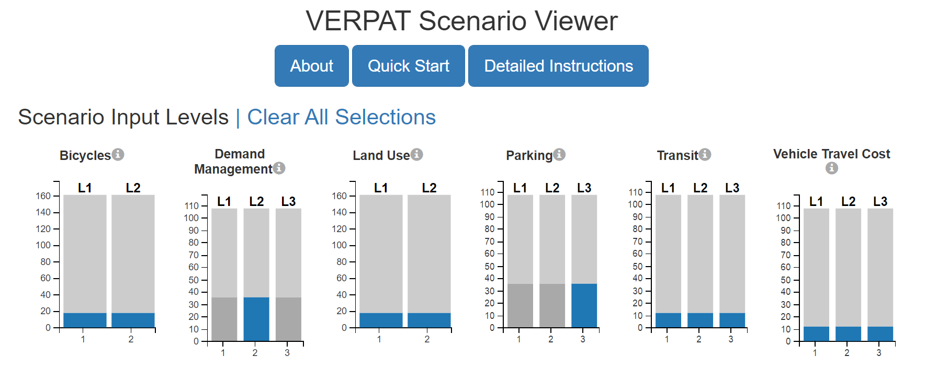
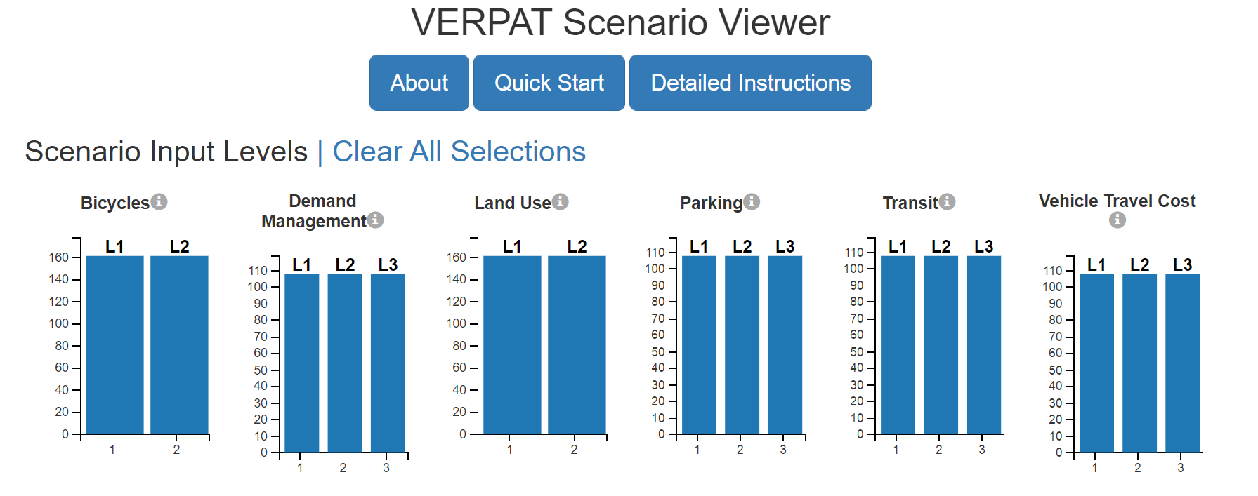
Scenario Definition
Based on the definition of new policies, we have a total of 324 different scenarios
Each combination can be chosen through the Visualizer webpage of VERPAT output folder
Selecting “new policy I” for Demand Management and “new policy II” for parking:
Notes:
Several levels were defined for each of the categories. These levels are numbered to indicate the amount of change from a reference case which represents the continuation of adopted local plans, policies and trends.
Level 1: Corresponds to current conditions.
Levels 2-3: Representing more ambitious policies.
The levels are displayed in scenario bar charts in the visualizer page of the output folder of VERPAT. There will be one bar chart for each category, as shown in the following illustration.
The sizes of the bars show the proportions of the selected scenarios in each level. The number of selected scenarios in each level is shown in the corresponding bar. You can select (or deselect) the scenarios in a level by either clicking on the bar. The selected level is colored, and the non-selected levels are grayed-out. The total count of unfiltered scenarios is shown in light gray. An example will be to select Demand Management scenario input level 2 and Parking scenario input level 3 and the final figure will be as below.

Slide 45
Outcomes
The performance metrics reported by VERPAT for each policy scenario:
Fatalities & Injuries: annual traffic fatalities and injuries per 1000 persons
Vehicle Cost Per Capita: average annual cost for owning & operating vehicles per person
DVMT Per Capita: average daily vehicle miles traveled per person
GHG Emissions Per Capita: average annual metric tons of greenhouse gas emissions per person
Fuel Consumption: average annual gallons of gasoline and other fuels consumed per person
DVHT Per Capita: average daily vehicle hours of travel per person
Notes:
A large number of performance metrics are produced during the run of the RPAT model, including environment and energy impacts, financial and economic impacts, and community impacts. For simplicity, six key metrics are calculated from multiple scenario runs and are shown on the Scenario Viewer output page:
Fatalities & Injuries: annual traffic fatalities and injuries per 1000 persons
Vehicle Cost Per Capita: average annual cost for owning and operating vehicles per person
DVMT Per Capita: average daily vehicle miles traveled per person
GHG Emissions Per Capita: average annual metric tons of greenhouse gas emissions per person
Fuel Consumption: average annual gallons of gasoline and other fuels consumed per person
DVHT Per Capita: average daily vehicle hours of travel per person
Each one is displayed as a histogram of the number of scenarios.

Slide 46
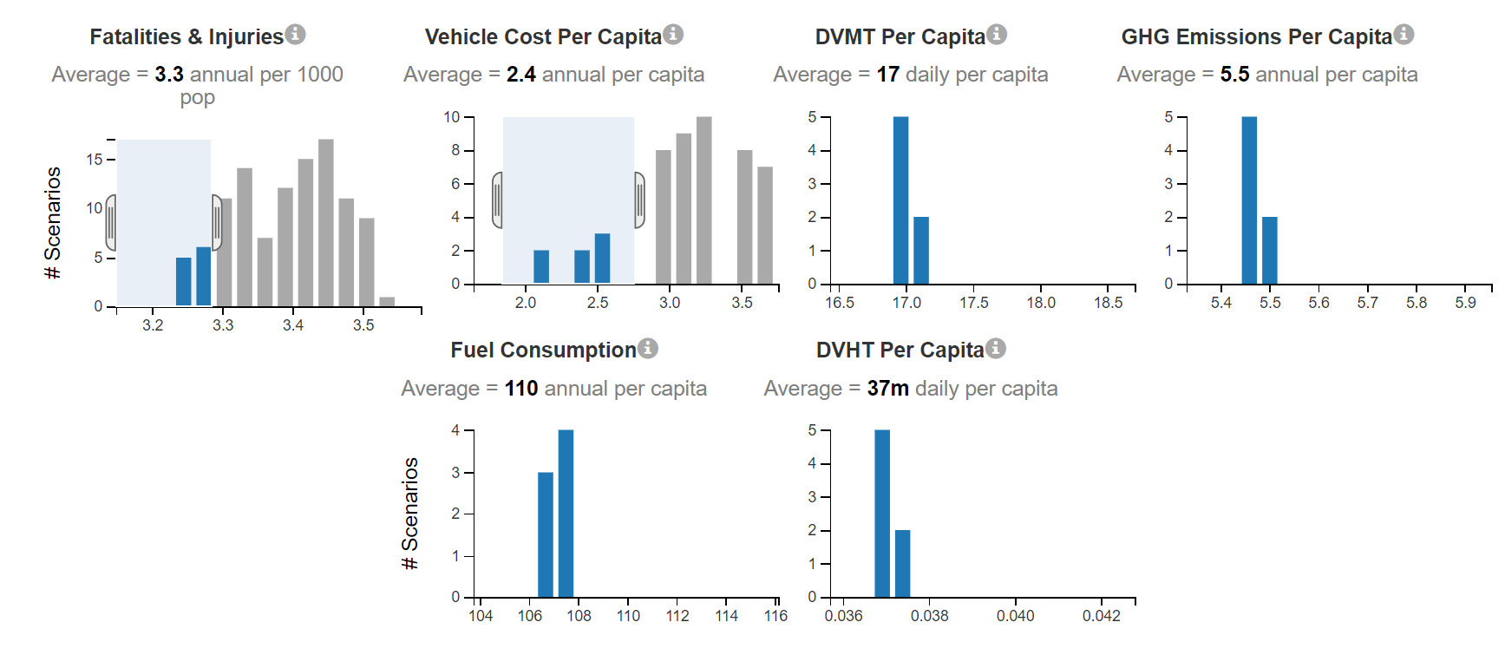
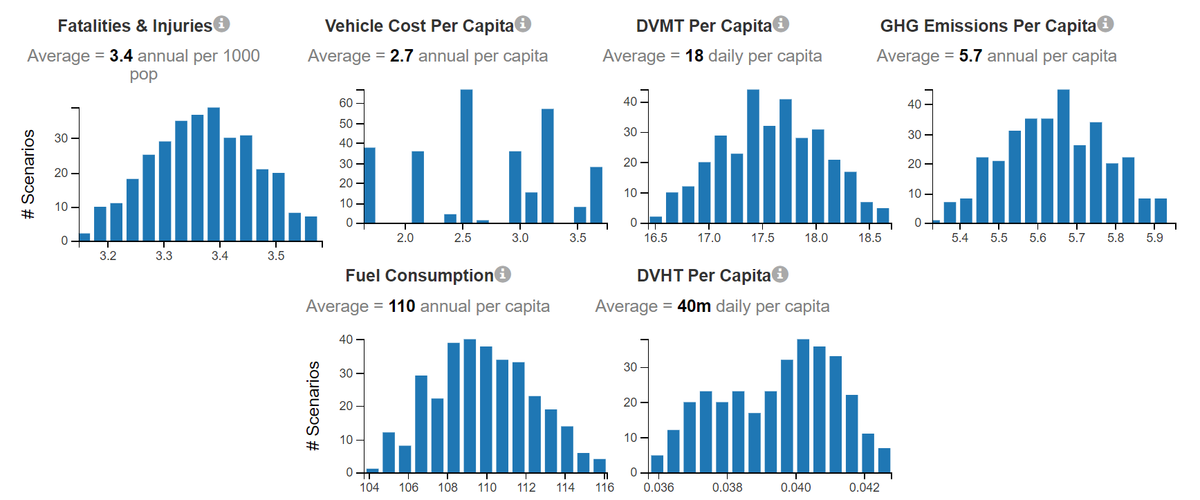
Outcomes
The performance metrics reported by VERPAT for each policy scenario:
7 Scenarios out of
324 scenarios fit
in the criteria!
Notes:
Each outcome is illustrated in a bar chart showing the range of outcome values for the selected scenarios. The bar height indicates the number of selected scenarios with that outcome value. The average value for all of the selected scenarios is shown above the bar chart. The following illustrations shows that the bar charts can also be used to make a selection of scenarios. This can be done by hovering the mouse cursor over the bar at one end of the desired selection range. When the cursor is in the shape of a crosshairs, click and drag the mouse cursor to the other end of the desired range. The bar chart will change to show the selected range.
If we do so with the Fatalities & Injuries and Vehicle Cost Per Capita bar charts, we will see that only 7 scenarios out of 324 scenarios are selected and their corresponding results will be shown in the table of performance metrics below these charts.

Slide 47
Scenario Performances
Depends on the value of each performance measure in the eye of the operators!
Let’s see each scenario and its corresponding performance measures:
Potential Scenarios | Bicycles | Demand Management | Land Use | Parking | Transit | Vehicle Travel Cost | Fatalities & Injuries | Vehicle Cost Per Capita | DVMT Per Capita | GHG Emissions Per Capita | Fuel Consumption | DVHT Per Capita
Base Scenario (no changes to the current condition) | 1 | 1 | 1 | 1 | 1 | 1 | 3.5833 | 1.6896 | 18.7074 | 5.9552 | 116.1528 | 0.0428
Single Scenario Effects
Bicycles #2 | 2 | 1 | 1 | 1 | 1 | 1 | 3.572 | 1.6846 | 18.6442 | 5.9355 | 115.7597 | 0.0427
Demand Management #2 | 1 | 2 | 1 | 1 | 1 | 1 | 3.5802 | 1.6883 | 18.6914 | 5.9501 | 116.0533 | 0.0428
Demand Management #3 | 1 | 3 | 1 | 1 | 1 | 1 | 3.5255 | 1.667 | 18.4011 | 5.8595 | 114.2484 | 0.0421
Land Use #2 | 1 | 1 | 2 | 1 | 1 | 1 | 3.5513 | 1.6771 | 18.5353 | 5.9018 | 115.0895 | 0.0424
Parking #2 | 1 | 1 | 1 | 2 | 1 | 1 | 3.5771 | 1.7579 | 18.6747 | 5.9469 | 115.9353 | 0.0427
Parking #3 | 1 | 1 | 1 | 3 | 1 | 1 | 3.5358 | 2.1646 | 18.46 | 5.8887 | 114.5436 | 0.0422
Transit #2 | 1 | 1 | 1 | 1 | 2 | 1 | 3.5193 | 1.6838 | 18.3688 | 5.8586 | 114.4489 | 0.0417
Transit #3 | 1 | 1 | 1 | 1 | 3 | 1 | 3.413 | 1.6938 | 17.8122 | 5.7081 | 112.2833 | 0.0393
Vehicle Travel Cost #2 | 1 | 1 | 1 | 1 | 1 | 2 | 3.5204 | 2.614 | 18.3775 | 5.8699 | 113.9791 | 0.042
Vehicle Travel Cost #3 | 1 | 1 | 1 | 1 | 1 | 3 | 3.4543 | 3.3147 | 18.0299 | 5.7761 | 111.7164 | 0.0413
25% Quartile of Performance Measures (all scenarios included) |  |  |  |  |  |  | 3.3144 | 2.134575 | 17.29955 | 5.565775 | 108.4483 | 0.0383
50% Quartile of Performance Measures (all scenarios included) |  |  |  |  |  |  | 3.38351142 | 2.672144444 | 17.6604213 | 5.665058333 | 110.2666978 | 0.039725617
Notes:
In order to specify the best performed scenario, we as planners should observe what is the goal of our planning scheme. Each one of the performance metrics in VERPAT can be weighted differently, however, in this analysis we assume that these metrics are weighted equally in terms of significance. First, we will compare each scenario and their corresponding performance measure separately. As a user-defined standard, we will use the 25% quartile and 50% quartile (mean value) of each performance metric and compare the value to the outcome of each single scenario. As we can see in the table, none of the single scenarios performed better in comparison to the mean values of the performance metrics. However, we will not stop here and will compare each scenario with the other scenarios to see out of these 10 scenarios, which ones performed better.

Slide 48
Best Scenario(s)?
Ranking the scenarios based on their performance rankings:
Best 5 scenarios are:
VMT pricing
Improvement of transit supply
Parking Pricing and Land use development
Potential Scenarios | Fatalities & Injuries | Vehicle Cost Per Capita | DVMT Per Capita | GHG Emissions Per Capita | Fuel Consumption | DVHT Per Capita | Rank Sum
Bicycles #2 | 8 | 7 | 8 | 8 | 8 | 9 | 48
Demand Management #2 | 10 | 6 | 10 | 10 | 10 | 10 | 56
Demand Management #3 | 5 | 10 | 5 | 4 | 4 | 5 | 33
Land Use #2 | 7 | 9 | 7 | 7 | 7 | 7 | 44
Parking #2 | 9 | 4 | 9 | 9 | 9 | 9 | 49
Parking #3 | 6 | 3 | 6 | 6 | 6 | 6 | 33
Transit #2 | 3 | 8 | 3 | 3 | 5 | 3 | 25
Transit #3 | 1 | 5 | 1 | 1 | 2 | 1 | 11
Vehicle Travel Cost #2 | 4 | 2 | 4 | 5 | 3 | 4 | 22
Vehicle Travel Cost #3 | 2 | 1 | 2 | 2 | 1 | 2 | 10
Notes:
In the performance metrics, we are looking to replace SOVs with other safe and eco-friendly modes of travel, therefore, we are looking at scenarios that have low fatalities, higher vehicle cost of ownership and operation, lower DVMT and DVHT, lower GHG emission, and lower fuel consumption. We will rank these scenarios based on this standard and will sum the ranks. The lower the summation of the ranks, the better that scenario has performed.
All in all, VMT pricing and major growth in arterial and freeway supplies and increase of transit revenue per capita performed well, and parking pricing policy 2 and demand management policy 2 are in the next ranks.
Again, as a reminder, we are weighing the performance metrics equally, and this can be changed with any user-defined weighing system, and therefore, the selected best scenario can be changed.

Slide 49
Best Scenario(s)?
What is the compound effect of the combination of scenarios?
Combination of scenarios can make significant improvements in achieving performance measurement goals!
Not only in comparison with 50% percentile but also compared to 25% percentile values of performance measures, they did well
Potential Scenarios | Fatalities & Injuries | Vehicle Cost Per Capita | DVMT Per Capita | GHG Emissions Per Capita | Fuel Consumption | DVHT Per Capita
Base Scenario (no changes to the current condition) | 3.5833 | 1.6896 | 18.7074 | 5.9552 | 116.1528 | 0.0428
Best Combinations of Scenarios
Vehicle Travel Cost #3 + Transit #3 | 3.237 | 3.395 | 16.898 | 5.466 | 106.558 | 0.037
Transit #3 + Parking #3 | 3.267 | 2.938 | 17.051 | 5.503 | 107.537 | 0.037
Vehicle Travel Cost #3 + Parking #3 | 3.288 | 3.694 | 17.162 | 5.532 | 107.082 | 0.039
Vehicle Travel Cost #3 + Bicycles #2 | 3.315 | 3.416 | 17.302 | 5.571 | 107.972 | 0.039
Vehicle Travel Cost #3 + Transit #2 + Parking #3 | 3.300 | 3.696 | 17.227 | 5.549 | 107.179 | 0.039
Vehicle Travel Cost #3 + Transit #3 + Parking #3 | 3.206 | 3.665 | 16.733 | 5.422 | 105.536 | 0.036
25% Quartile of Performance Measures | 3.314 | 2.135 | 17.300 | 5.566 | 108.448 | 0.038
50% Quartile of Performance Measures | 3.384 | 2.672 | 17.660 | 5.665 | 110.267 | 0.040
Notes:
However, we will move forward and combine policies to see how well the combined policies perform. We combine best single scenarios of VMT charging, Transit supply, and parking pricing and observe that almost all of them performed better compared to the 25% quartile of the performance metrics! We will do the comparison of the combined policies and rank their performance metrics (same as what we did for single scenarios) in the next slide.

Slide 50
Best Scenario(s)?
What is the compound effect of the combination of scenarios?
Best option would be to:
Increase proportion of Employees that charge for parking by 20%
Increase proportion of non-free parking spots by 20%
Double the average daily parking cost
Impose a pricing of 9 cents per mile on network roads
Increase the supply of freeway and arterial roads by 200% compared to population growth
Increase the revenue per mile of bus and rails by 200% compared to population growth
Potential Scenarios | Fatalities & Injuries | Vehicle Cost Per Capita | DVMT Per Capita | GHG Emission Per Capita | Fuel Consumption | DVHT Per Capita | Rank Sum
Vehicle Travel Cost #3 + Transit #3 | 2 | 5 | 2 | 2 | 2 | 2 | 15
Transit #3 + Parking #3 | 3 | 6 | 3 | 3 | 5 | 2 | 22
Vehicle Travel Cost #3 + Parking #3 | 4 | 2 | 4 | 4 | 3 | 4 | 21
Vehicle Travel Cost #3 + Bicycles #2 | 6 | 4 | 6 | 6 | 6 | 4 | 32
Vehicle Travel Cost #3 + Transit #2 + Parking #3 | 5 | 1 | 5 | 5 | 4 | 4 | 24
Vehicle Travel Cost #3 + Transit #3 + Parking #3 | 1 | 3 | 1 | 1 | 1 | 1 | 8
Notes:
By ranking the performance metrics of the combined scenarios, we observe that combining VMT charging of 9 cents per mile, triple growth of arterial and freeway roadway expansion and transit revenue per capita compared to population growth and doubling parking average daily parking cost and increase proportion of Employees that charge for parking by 20% will be the optimal scenario to select.

Slide 51
Best Scenario(s)?
What is the compound effect of the combination of scenarios?
Best option would be to:
Increase proportion of Employees that charge for parking by 20%
Increase proportion of non-free parking spots by 20%
Double the average daily parking cost
Impose a pricing of 9 cents per mile on network roads
Increase the supply of freeway and arterial roads by 200% compared to population growth
Increase the revenue per mile of bus and rails by 200% compared to population growth
One major benefit of this scenario is the potential use of revenue from VMT and parking tolls in expanding
transit revenue per mile as well as building the new facilities (freeway and arterial road extensions).
One major drawback of our analysis would be lack of cost estimation data in order to better analyze the
scenarios cost-wise, and finding the optimal scenario which meets our performance measure goals as well
as being cost-effective.
Notes:
Additional information on the induced demand shows that following initial calculations for baseline conditions, the model has feedback loops, which allow for changes in travel demand and other impacts based on induced travel demand and for changes in policies for a given scenario. Congestion is recalculated following these adjustments to demand. Induced demand is calculated for changes in roadway supply in the near term as a function of speed, based on potential mode and route shifts to produce changes in VMT and in the longer term to include changes in vehicle ownership, still as a function of speed. This model does not include induced demand as a result of changes in growth that may occur as part of a smart growth scenario because the evidence is limited empirical evidence.

Slide 52
References
https://visioneval.org
https://github.com/VisionEval/VisionEval/wiki
https://www.oregon.gov/odot/Regions/Pages/index.aspx
https://www.dot.ny.gov/divisions/engineering/technical-services/trans-r-and-d-repository/C-17-05_Implementation_of_a_regional_greenhouse_gas_reduction.pdf

Slide 53
Thank you!

